Slide 1
Not so long ago, in a drainage branch right here in Kentucky….

Slide 2
DRAINAGE DESIGN
SOFTWARE WARS

Slide 3
Episode MMMCCXLIV
(That’s Episode 3,244 for those of you that don’t do the Roman Numeral thing. Doesn’t it seem like we have had that many drainage software programs???)
RELEASE OF THE KYTC ORD DRAINAGE STANDARDS
15 years ago, the fearless KYTC Drainage Branch Manager, David Moses, was leading an effort to use Bentley’s drainage program, Inroad’s STORM AND SANITARY.
Little did David know, Bentley was working on a new, more powerful design package – ORD!!! With this program, the approach to both roadway and drainage design would be changed forever!
Now the current KYTC Drainage Branch, led by the somewhat competent Tim Robinson, is struggling to catch up. With the help of the incomparable Erika Smith, KYTC’s Drainage Branch is ready to unleash their latest ORD standards….

Slide 4
YOUR PRESENTERS
Erika Smith
FAMOUS QUOTE:
“ Give a man a fish, he eats for a day. Teach a man to fish so he leaves you the ‘heck’ alone.”
Tim Robinson
FAMOUS QUOTE:
“ Don’t be an ‘idiot.’ ”
Notes:
Erika to wave, smile and say ‘Hi!!!’

Slide 5
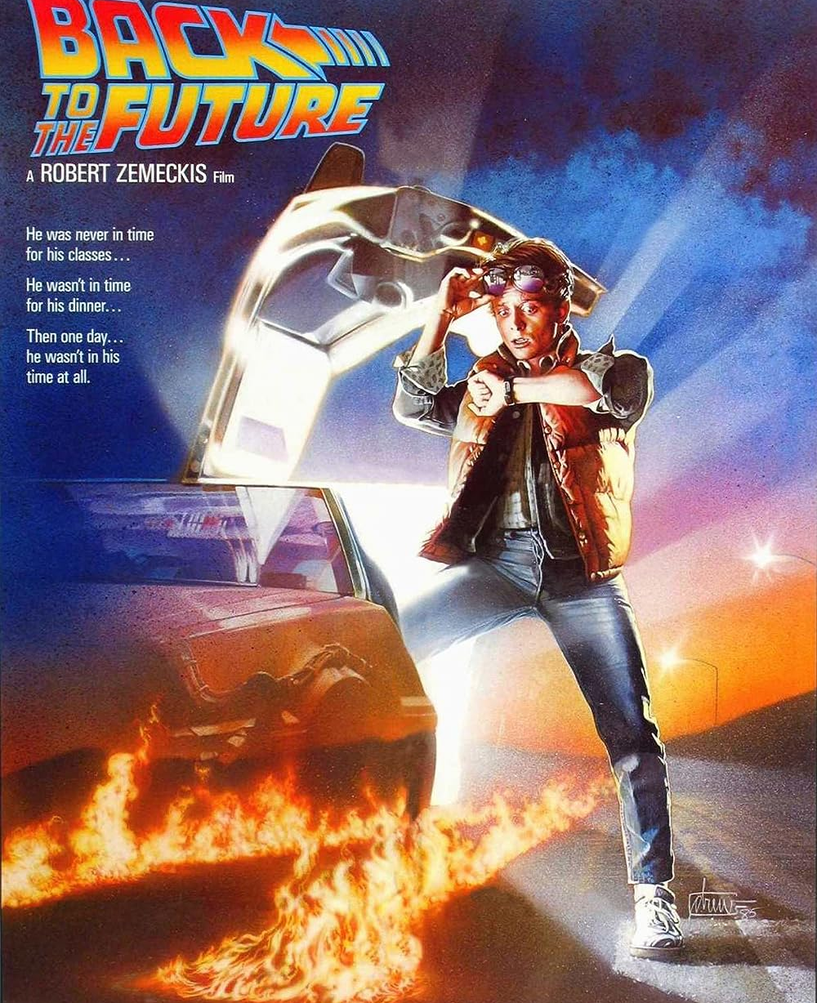
KYTC Drainage Workspace expectations and updates
When – Mid Sept KYTC and
Late Sept External
???
What – The move from ORD 10.10 to 10.12 and the update of KYTC ORD Standards
The Who – Anyone beginning drainage designs for new KYTC projects and current projects that meet certain criteria

Slide 6
Projects That Are Currently Being
Designed in ORD Drainage – Should I Upgrade?
Percent of Project Completion and Recommendation of Upgrading ORD DU
Not Recommended
Not highly recommended
Especially if large project
Recommended, if before JI
And not a lot of inlets to redo
Highly Recommended

Slide 7
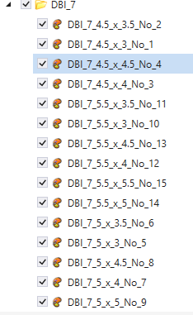
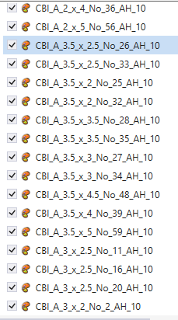
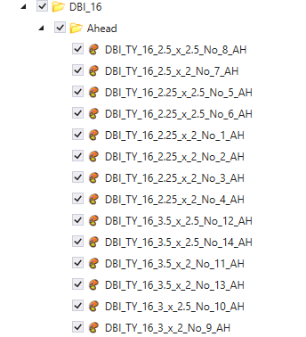
Why Should I Upgrade?
KYTC Workspace Updates
Larger selection of drainage structures
We tried to get everything in the Standard Drawings
Did our best to make the drainage structure vaults accurate, which should allow designer to see
Constructability
Pipe entry angles
Utility conflicts in 3D
Note the vaults do NOT automatically show up on the plan view
New inlet structures will also incorporate risers where necessary
Included all the headwalls in the Headwall Standard Drawings
AUDIENCE APPLAUSE!!!!!

Slide 8
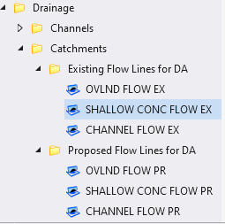
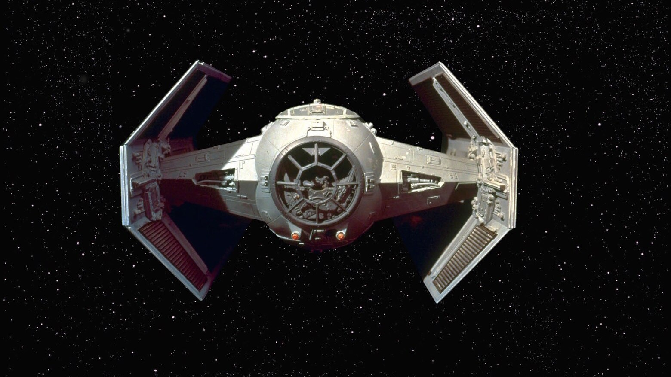
Why Should I Upgrade?
KYTC Workspace Updates
We added line styles for the components for Time of Concentration
Overland flow
Shallow concentrate flow
Channel Flow
6 total – 3 for existing drainage and 3 for proposed
Release 10.12 appears to be running much faster in our tests
More stable as well
Pipes now show both inside and outside walls on the plan view
Before it was a single line with direction arrows.

Slide 9
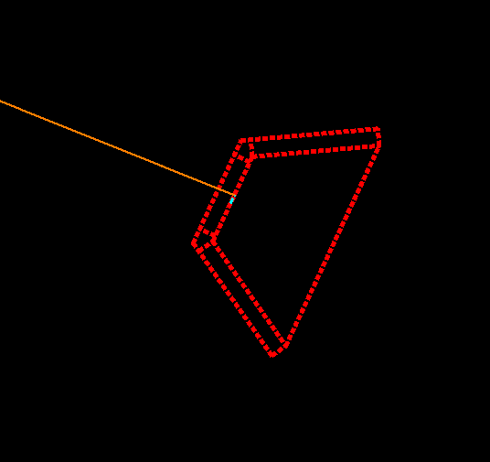
Apprehensions about updating vERSIONS mid-project
Concerns from Previous Updates:
Dropped to (X,Y,0)
Designs going haywire
Annotations ‘breaking’
Inverts changing
Parts of the design go missing
Parts of the design turn red and dashed

Slide 10
Potential Causes
of These Issues
Changes in the configuration variables
New configuration variables may have been set
Designs may change because cells are updated
Feature definitions or element templates may have been updated
Cells may no longer exist and it breaks a link causing the node to disappear.
Rules lost or removed may cause red and dashed nodes or “random” value changes

Slide 11
Why you should have fewer reservations about updating...
The workspace has been completely revamped
New feature definition names
Inlets that were placed in a previous version won’t change or update
They don’t exist in the new one to change!
Civil labels are now set up in DGNLIB instead of XML files
Most of everything is made with new cells in a new cell library, new element templates, new symbologies
UPDATING VERSIONS DOESN’T ALWAYS MEAN YOU HAVE TO UPDATE THE OLD INFORMATION

Slide 12
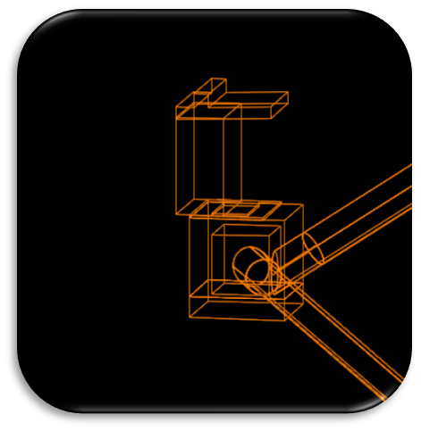
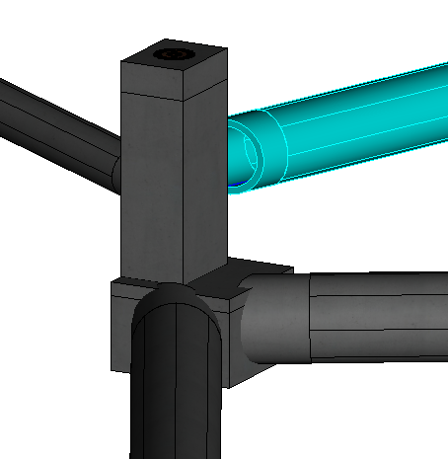
CO Drainage hasn’t received many support tickets to better understand all the concerns.
¯\(°_o)/¯
PLEASE SUBMIT TICKETS!!!!!

Slide 13
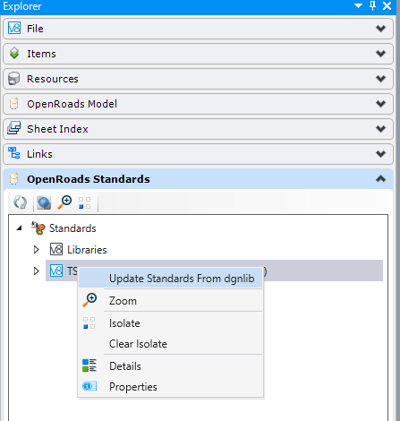
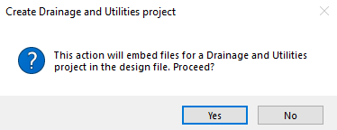
When updating to a new version of ORD, what gets copied, and when?
What is civil data?
From DGNLIB
products containing user-defined rules and relationships that enable dynamic intelligent updates to design data.
Element Templates
Text Favorites
Civil Labels
Feature Definitions
And more
From Design SeEd
Prototypes
Catalog Entries
Storm Data – 4 in/hr
Design Scenarios
Notes:
So why are we telling you about the feature definition names? What does this all mean for you guys, the users?
This is to help you be informed of what is changing with the standards and your design files, so that when you submit tickets, you are better able to communicate issues to us at KYTC.
What is civil data?
So where is this civil data stored? How is it used? When is it getting copied into my file?
The DGN Library is where this is all stored, it houses the civil data such as feature definitions, element templates, text favorites, and more. This all tells what to look like, when, and where. This gets copied into your design file when you use things like geometries and assign it a feature definition.
The drainage information is stored in a design seed, which happens to be the drainage DGN Library. This houses information such as storm data, prototypes, and catalog entries. So what are some of these civil data? What do these do? Catalog entries and prototypes house the hydraulic information of the structures and the feature definitions point to these to tell it what properties to use.
So when does the drainage information get copied over?
Has anyone seen this box? If you haven’t shame on you because this is where it all starts for drainage and utility design. This box is where you say “yes” or “no” to drainage information being permanently embedded into the file. This copies the CURRENT prototypes and catalog entries as well as other drainage information into the file.
If you have started a drainage project in ORD DU 10.10 already, and you upgrade to the 10.12 version, you will need to update the standards. However, if you start a new one in ORD DU 10.12 you should be fine.

Slide 14
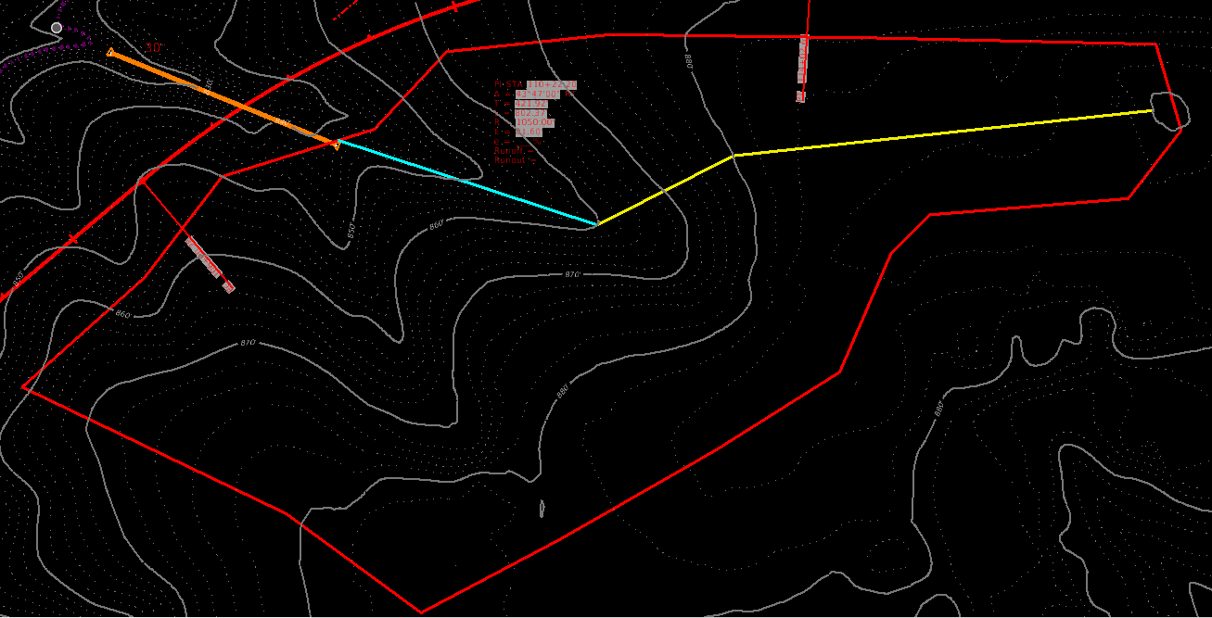
What is KYTC Asking me to do/model?
Physically model all existing and proposed drainage areas and times of concentration
For the drainage areas and Tc calcs, KYTC wants ORD drainage files as the source data
Only use the KYTC spreadsheet and/or the FHWA toolbox as a CHECK

Slide 15
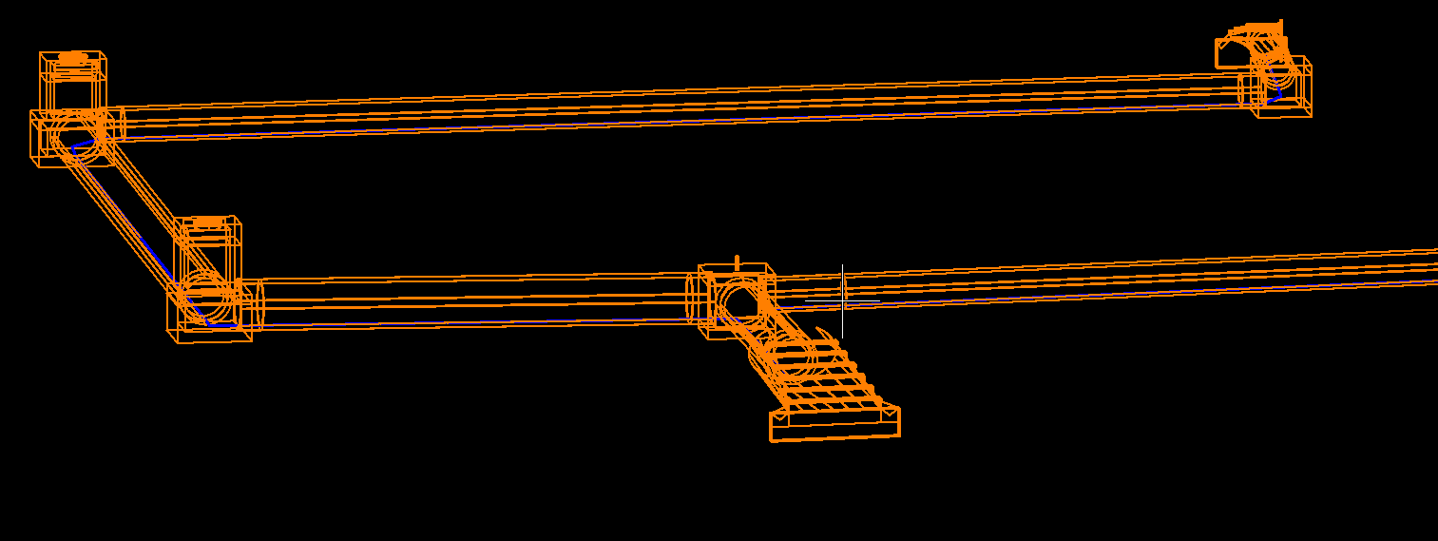
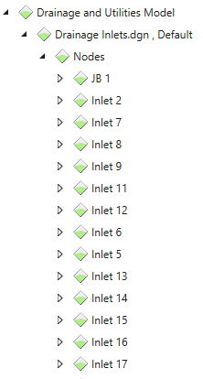
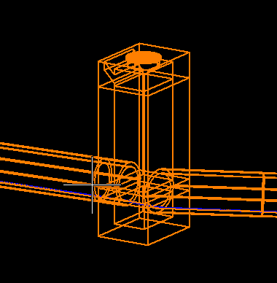
What is KYTC Asking me to do/model?
PHYSICALLY model all drainage structures. This includes
Culvert pipes – including headwalls
Storm sewer pipes
Inlets
Manholes
Junction Boxes

Slide 16
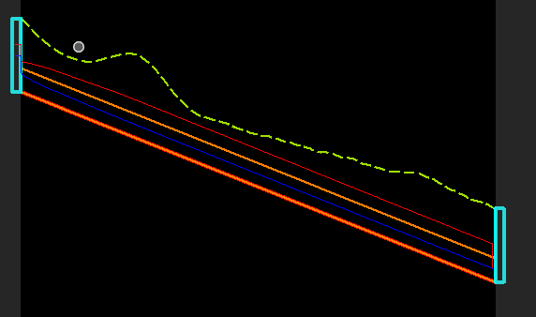
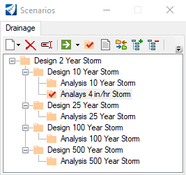
What is KYTC Asking me to do/model?
Model
Storm sewer pipes and nodes (inlet vaults/manholes/junction boxes)
10-year design for 80% flow depth over storm sewer pipe rise (25 year for systems downstream of sag inlets)
100-year HGL
Pavement spread (using the provided 4 in/hr)

Slide 17
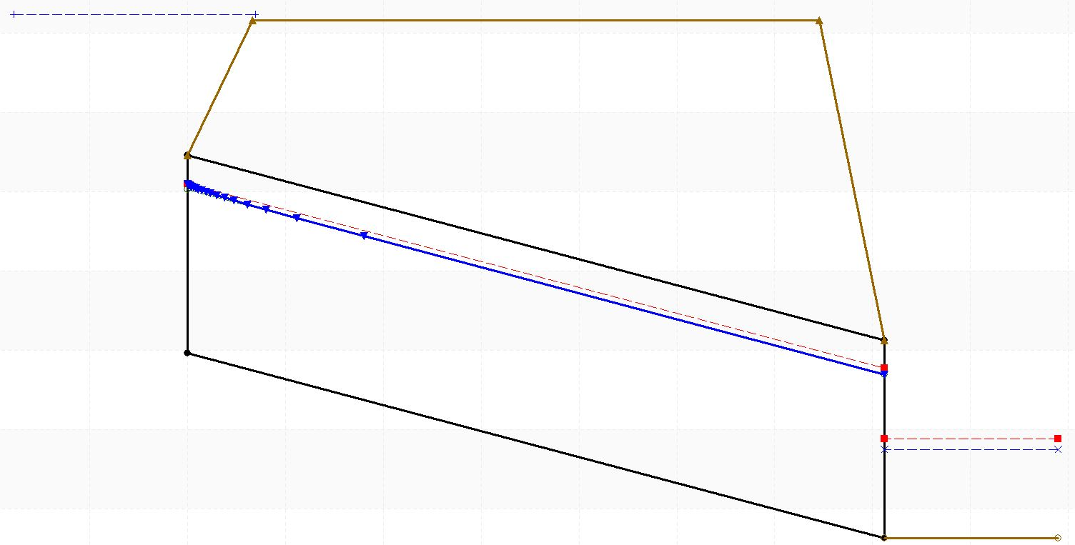
What is KYTC asking me to model outside ORD?
FOR THE MOMENT
Culvert headwater analysis
Continue to use HY-8 for this analysis
This includes headwall inlets into storm sewer systems.
KYTC is optimistic Bentley will be correcting the issues with its culvert headwater analysis in a future release in the near future.

Slide 18
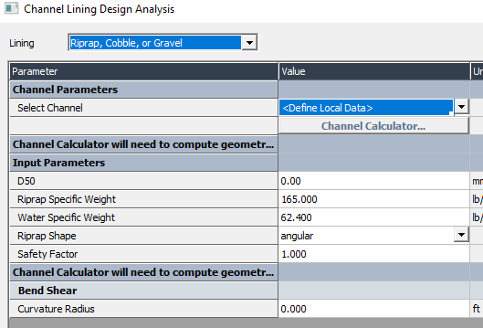
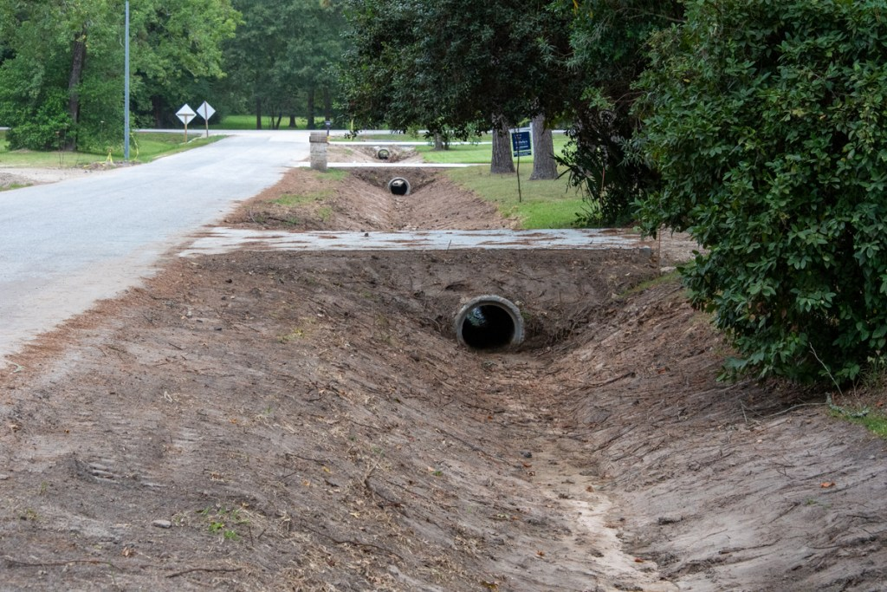
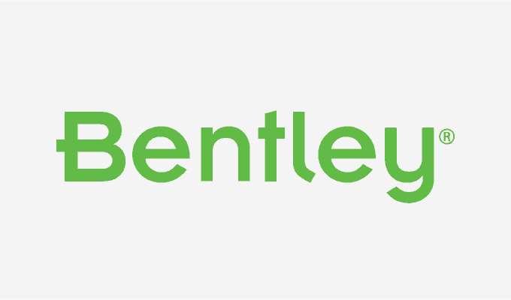
What is KYTC asking me to model outside ORD?
FOR THE MOMENT
Channel Lining Analysis
Continue to use the current KYTC Spreadsheet
FHWA Toolbox Analysis is acceptable as well
Bentley has shown a keen interest in providing this analysis

Slide 19
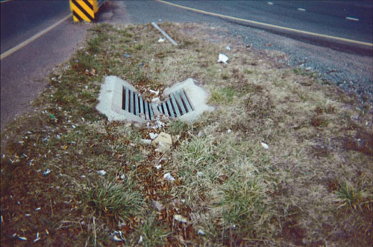
What is KYTC asking me to model outside ORD?
FOR THE MOMENT
Grated inlet analysis
ORD currently does NOT allow for ditches to flow to the grate of an inlet
Only flow from catchments can be read and analyzed
KYTC has been working with Bentley to fix this issue

Slide 20
What Is KYTC Asking Me to Submit?
https://transportation.ky.gov/Highway-Design/Pages/Drainage-Folder.aspx

Slide 21
How to – Time Concentration EXAMPLE
Reference Terrain with contours
Existing Terrain at 10-foot major/2-foot minor contours
If drainage area is outside project mapping, download 5-foot Statewide LIDAR, convert to Terrain, and display contours (trip around project mapping as needed.
Proposed Terrain at 1-foot major, 0.2-foot minor contours
Draw the catchment (drainage area) in question in.
Draw in line segments representing overland, shallow concentrate and channel flow.
Multiple line segments can be used for shallow concentrated flow if there is a major change in slope or roughness.
An ORD profile can be pulled from the line segment to get the slope elements
For the channel flow, a line should also be drawn to show where a representative channel section is being used.
KYTC will have a spreadsheet that designer can enter basic X,Y elements of channel to get area and wetted perimeter.
If a channel isn’t evident, keep using shallow concentrate segments until it is!

Slide 22
Hopefully your MINDS HAVE BEEN BLOWN

Slide 23
QUESTIONS???

